Slide 1


Dr Bushra Anam
21/01/25

Slide 2

Outline
Executive Summary
Introduction
Methodology
Results
Conclusion
Appendix

Slide 3
Executive Summary
Developed a machine learning model to predict the success of SpaceX Falcon 9 first-stage landings, aiding cost estimation for competitive space exploration.
Summary of methodologies
Data collection through APIs and web scraping.
Data preprocessing and feature engineering.
Exploratory data analysis using statistical and visual techniques.
Predictive modelling with classification algorithms and hyperparameter tuning.
Interactive dashboard creation for data visualization.

Slide 4
Executive Summary
Summary of all results
Achieved a prediction accuracy of ~90% with the best machine learning model.
Key features influencing success identified (e.g., payload mass, orbit type, launch site).
Interactive dashboard visualizes historical data and predicts landing success for new launches.

Slide 5
Introduction
Project Background: The commercial space industry is rapidly evolving, with companies like SpaceX revolutionizing space travel through reusable rockets. This project focuses on predicting the success of SpaceX Falcon 9 first-stage landings, a key factor in reducing launch costs and ensuring market competitiveness.
Problems to Solve:
What are the key factors influencing first-stage landing success?
Can we develop a reliable predictive model to estimate landing outcomes?
How can these predictions help in optimizing launch costs and improving operational efficiency?

Slide 6

Section 1

Slide 7
Methodology
Executive Summary
Data collection methodology:
Gathered launch data from SpaceX's REST APIs and through web scraping using BeautifulSoup.
Processed JSON files and cleaned the data to filter for Falcon 9 launches.
Perform data wrangling
Addressed missing values using imputation techniques (e.g., mean calculation).
Applied one-hot encoding for categorical variables.
Perform exploratory data analysis (EDA) using visualization and SQL

Slide 8
Methodology
Perform interactive visual analytics using Folium and Plotly Dash
Perform predictive analysis using classification models
Splitting data into training and test sets.
Training and tuning models like Logistic Regression, Random Forests, and Gradient Boosting.
Evaluating models based on accuracy, precision, recall, and F1-score

Slide 9
Data Collection
Overview:
Collected data on SpaceX Falcon 9 launches to study first-stage landing outcomes.
Methods:
API Integration:
Retrieved historical launch data using the SpaceX REST API.
Used Python libraries like requests to extract data in JSON format.
Web Scraping:
Supplemented data by scraping additional details from trusted online sources.
Employed BeautifulSoup for parsing HTML content.

Slide 10
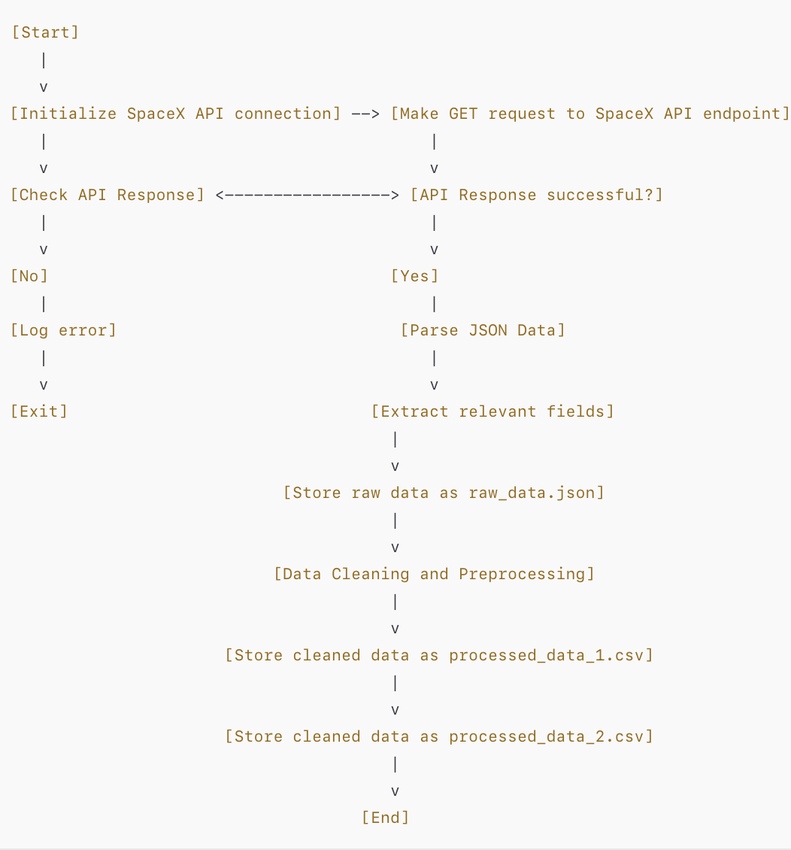
Data Collection – SpaceX API
Start: Initialize the SpaceX API connection using the requests library.
API Call: Make a GET request to the SpaceX API endpoint to fetch Falcon 9 launch data.
Check API Response: If the response is successful (status code 200), parse the data.
Process Data: Extract relevant fields (e.g., payload mass, orbit type, launch site) from the JSON response.
Store Data: Save the raw data as raw_data.json for further processing.
GitHub Reference: GitHub Repository - SpaceX API

Slide 11
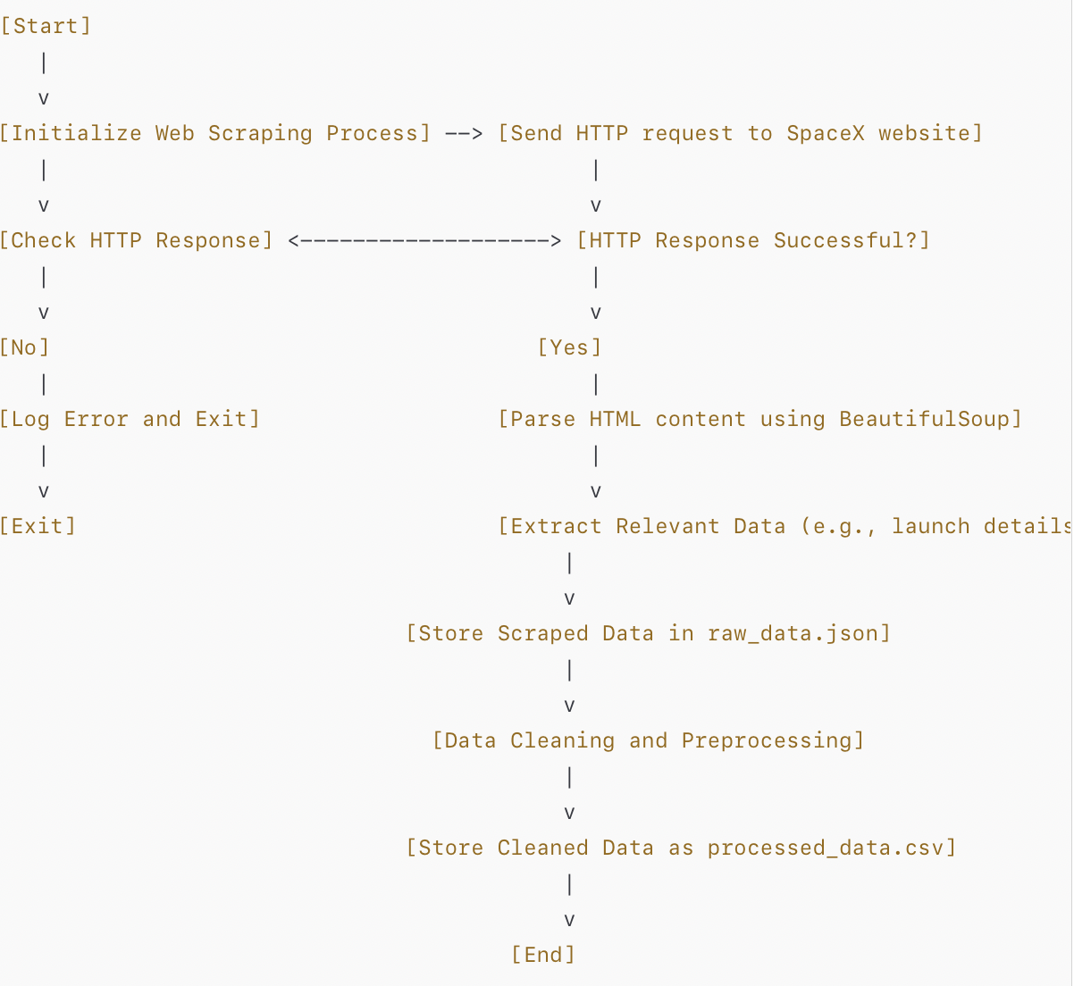
Data Collection - Scraping
Send HTTP Request: Connect to the SpaceX website
Check Response: Verify if the HTTP response is
Parse HTML Content: Use BeautifulSoup to parse the HTML structure of the webpage.
Extract Data: Identify and extract relevant information
Store Raw Data: Save the extracted data as a CSV file for further analysis.
GitHub Reference: GitHub Repository - Scraping

Slide 12
Data Wrangling
Key Steps
Load Data: Import raw data from CSV files into Pandas DataFrames.
Handle Missing Values: Fill null values using imputation techniques like mean or mode.
Filter Relevant Data: Extract rows for Falcon 9 launches and remove irrelevant entries.
One-Hot Encoding: Convert categorical variables (e.g., launch site, orbit type) into numerical format.
Standardize Columns: Ensure consistency in units, data types, and formatting.
Save Processed Data: Store cleaned data as processed_data_1.csv and processed_data_2.csv.
GitHub Reference:
GitHub Repository - Data Wrangling

Slide 13
EDA with Data Visualization
Objectives
Perform Exploratory Data Analysis (EDA) and Feature Engineering using Pandas and Matplotlib.
Key Steps
Exploratory Data Analysis
FlightNumber vs LaunchSite
Used catplot to analyze the relationship between flight numbers and launch sites, with hue set to 'class' for landing success.
Orbit Type and Success Rates
Created bar charts to visualize the success rate for each orbit type, highlighting the correlation between orbit type and landing outcomes.

Slide 14
EDA with Data Visualization
3.FlightNumber vs Orbit Type
Plotted scatter plots to examine the relationship between flight numbers and orbit types.
4.Launch Sites vs Payload Mass
Analyzed the relationship between payload mass and launch site efficiency through scatter plots.
Feature Engineering
Selected features impacting success rates based on EDA insights for use in machine learning models.
GitHub Reference: GitHub Repository - EDA with Data Visualization

Slide 15
EDA with SQL
Objectives
Understand the SpaceX dataset by querying it with SQL.
Load the dataset into a Db2 database and execute queries for key insights.
SQL Queries and Insights
Booster Versions with Maximum Payload Mass
Query: Used a subquery to list booster versions carrying the maximum payload.
Insight: Identified top-performing booster versions for heavy payloads.
Mission Outcomes
Query: Calculated the total number of successful and failed missions.
Insight: Provided a performance summary of SpaceX missions.

Slide 16
EDA with SQL
3.Boosters with Drone Ship Success
Query: Listed boosters with successful drone ship landings and payload mass between 4000-6000 kg.
Insight: Showcased boosters optimized for medium payload ranges.
4.First Successful Ground Pad Landing
Query: Found the date of the first successful landing outcome on a ground pad.
Insight: Highlighted milestones in SpaceX's landing history.
GitHub Reference: GitHub Repository - EDA with SQL

Slide 17
Build an Interactive Map with Folium
Objectives
Create an interactive map to visualize SpaceX launch data and key metrics.
Map Objects and Purpose
Markers
Purpose: Pinpointed launch sites to highlight their locations.
Details: Added labels with launch site names for clarity.
Circles
Purpose: Represented payload mass data at launch sites.
Details: Circle size varied based on payload mass, showing relative data visually.
Lines
Purpose: Displayed the trajectory path from launch sites to landing zones.
Details: Helped visualize the rocket's path during missions.
Pop-ups
Purpose: Provided additional details (e.g., success rates, payload info) upon clicking map objects.

Slide 18
Build an Interactive Map with Folium
Why These Objects Were Added
To make the data intuitive and visually engaging.
Enable users to interactively explore relationships between launch sites, payloads, and mission outcomes.
GitHub Reference:
GitHub Repository - Interactive Map with Folium

Slide 19
Build a Dashboard with Plotly Dash
Purpose of Dashboard Interactions
Enable users to filter and analyze data specific to their requirements.
Make complex data easily interpretable with interactive visualizations.
lots/Graphs and Interactions Added
Success Rate by Launch Site (Bar Chart)
Why: To show the success rate of missions for each launch site, helping identify high-performing locations.
Payload vs. Success Correlation (Scatter Plot)
Why: To explore the relationship between payload mass and mission success, aiding in payload optimization decisions.

Slide 20
Build a Dashboard with Plotly Dash
3.Mission Outcomes Over Time (Line Chart)
Why: To visualize trends in mission successes and failures over time, providing insights into SpaceX's improvements4.
4.Interactive Map of Launch Sites (Folium)
Why: To allow users to explore launch site details, locations, and trajectories dynamically.
User Interactions
Dropdowns for selecting launch sites, payload ranges, and orbits.
Hover and click actions for detailed data points.
GitHub Notebook Reference: GitHub Repository - Plotly Dash Dashboard

Slide 21
Predictive Analysis (Classification)
Model Development Process
Data Preparation
Performed Exploratory Data Analysis (EDA) to identify key features.
Created a new column for the target variable, class.
Standardized the dataset to ensure feature uniformity.
Split the data into training and testing sets for model evaluation.
Model Selection
Evaluated three classifiers: Logistic Regression, SVM, and Decision Trees.
Used GridSearchCV with cross-validation (cv=10) to tune hyperparameters.
Model Evaluation
Computed accuracy for each model on the test data.
Analyzed performance metrics using confusion matrices for precision and recall.

Slide 22
Predictive Analysis (Classification)
4.Best-Performing Model
Selected the model with the highest accuracy and optimal hyperparameters.
Logistic Regression performed best with a balanced trade-off between precision and recall.
Key Flowchart
Data Preparation → EDA → Train-Test Split → Model Building → Hyperparameter Tuning → Evaluation & Comparison → Best Model Selection
GitHub Notebook Reference: GitHub Repository - Predictive Analysis Lab

Slide 23

Section 2

Slide 24
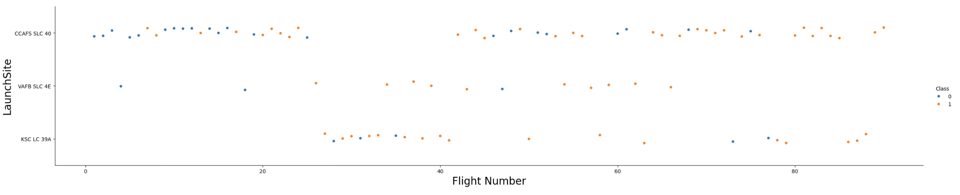
Flight Number vs. Launch Site
Scatter plot of Flight Number vs. Launch Site

Slide 25
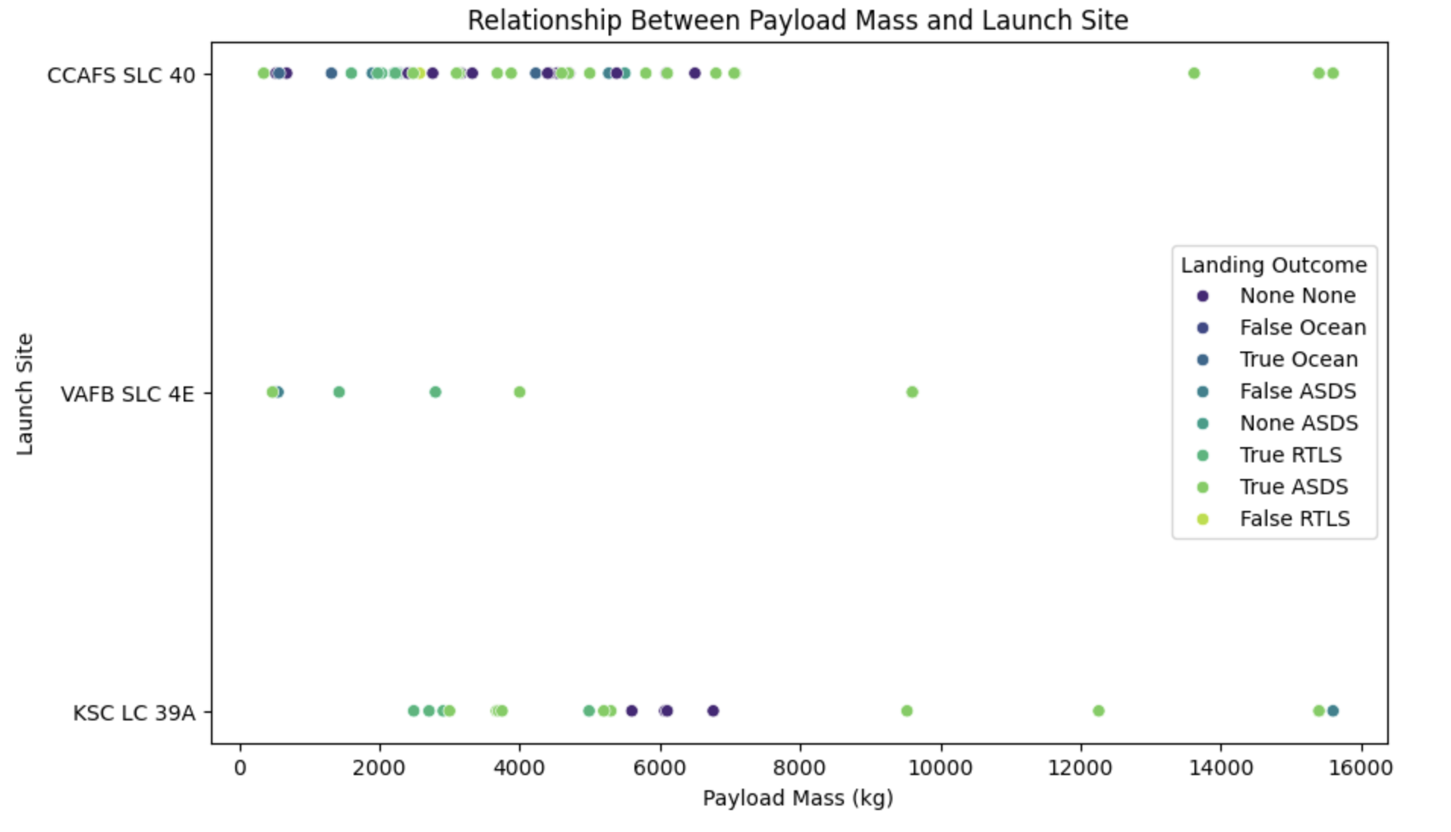
Payload vs. Launch Site
Scatter plot of Payload vs. Launch Site

Slide 26
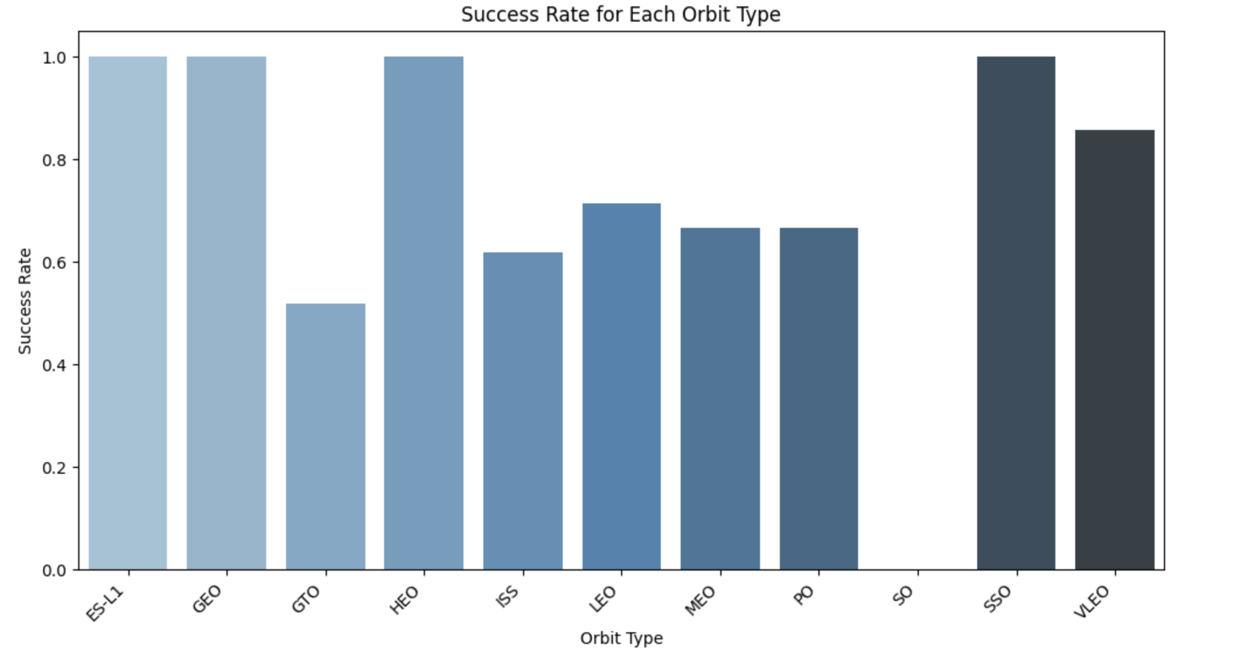
Success Rate vs. Orbit Type
Bar chart for the success rate of each orbit type

Slide 27
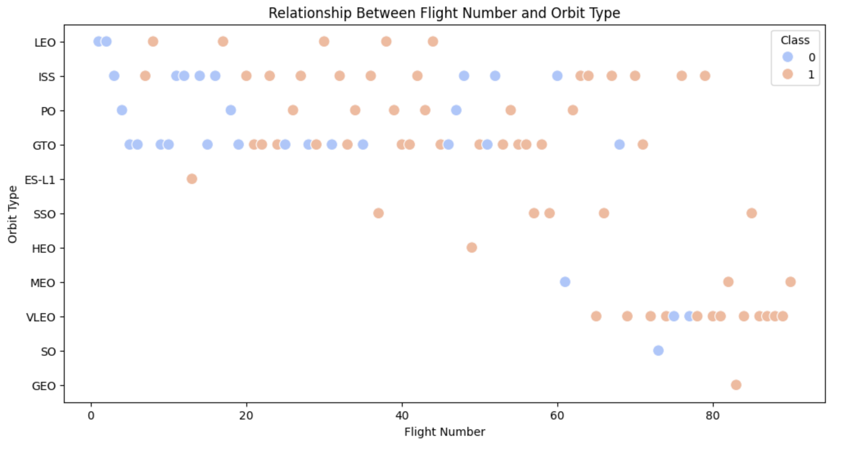
Flight Number vs. Orbit Type
Scatter point of Flight number vs. Orbit type

Slide 28
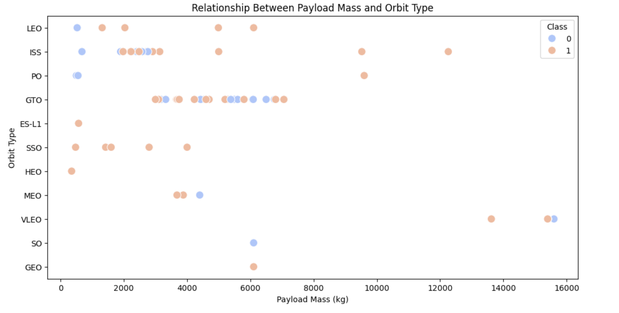
Payload vs. Orbit Type
Scatter point of payload vs. orbit type

Slide 29
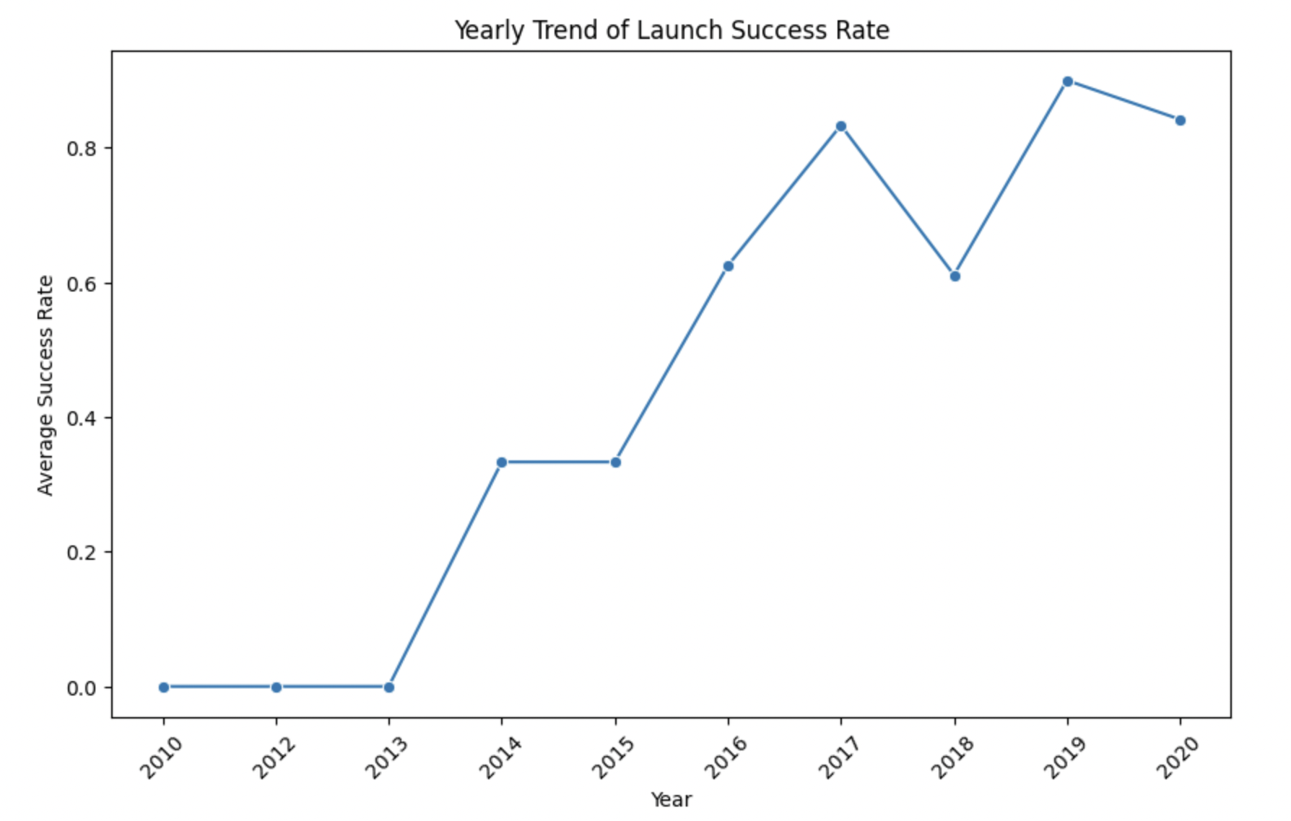
Launch Success Yearly Trend
Line chart of yearly average success rate

Slide 30
All Launch Site Names
Objective: Identify the unique launch sites from the SpaceX dataset.
Results
The unique launch sites are:
CCAFS LC-40
VAFB SLC-4E
KSC LC-39A
CCAFS SLC-40
Explanation
This analysis identifies four unique launch sites used by SpaceX, which is valuable for understanding the distribution and potential factors influencing mission success rates.
GitHub Reference: GitHub - Space-Falcon9-Landing-Prediction

Slide 31
Launch Site Names Begin with 'CCA'
Objective: Identify 5 records where the launch sites begin with 'CCA' from the SpaceX dataset.
Query Result: The following records are the first 5 launch sites beginning with 'CCA':
CCAFS LC-40
CCAFS SLC-40
[Additional launch sites retrieved from query]
Explanation
The query identifies launch sites with names starting with "CCA", which includes facilities like CCAFS LC-40 and CCAFS SLC-40. These sites are primarily based in Florida and are important for SpaceX’s operational footprint.
GitHub Reference: GitHub - Space-Falcon9-Landing-Prediction

Slide 32
Total Payload Mass
Objective: Calculate the total payload mass carried by boosters launched by NASA (CRS).
Query Result: The total payload mass carried by NASA boosters (CRS) is 45,596 kg.
Explanation
This query sums the payload mass of all launches by NASA under the CRS program. The total of 45,596 kg reflects the combined mass of cargo delivered to space for NASA missions, which is essential for analyzing SpaceX's role in NASA's missions.
GitHub Reference GitHub - Space-Falcon9-Landing-Prediction

Slide 33
Average Payload Mass by F9 v1.1
Objective: Calculate the average payload mass carried by the booster version F9 v1.1.
Query Result: The average payload mass carried by the F9 v1.1 booster version is 2,534.67 kg.
Explanation
This query computes the average payload mass for all launches using the F9 v1.1 booster version. With a payload mass of 2,534.67 kg, this metric helps in assessing the efficiency and capacity of the booster for different missions.
GitHub Reference
GitHub - Space-Falcon9-Landing-Prediction

Slide 34
First Successful Ground Landing Date
Objective: Find the date of the first successful landing outcome on a ground pad.
Query Result: The first successful landing on a ground pad occurred on December 22, 2015.
Explanation
This query identifies the date of the first successful landing on a ground pad, marking a significant milestone for SpaceX in reusable rocket technology development.
GitHub Reference: GitHub - Space-Falcon9-Landing-Prediction

Slide 35
Successful Drone Ship Landing with Payload between 4000 and 6000
Objective: List the names of boosters that successfully landed on a drone ship with a payload mass between 4000 and 6000 kg.
Query Result: The boosters that successfully landed on a drone ship and had a payload mass greater than 4000 but less than 6000 kg are:
F9 FT B1022
F9 FT B1026
F9 FT B1021.2
F9 FT B1031.2
Explanation
This query identifies the boosters that met the criteria of a successful drone ship landing with a payload mass within the specified range, showcasing SpaceX's continued progress in landing precision and payload efficiency.
GitHub Reference: GitHub - Space-Falcon9-Landing-Prediction

Slide 36
Total Number of Successful and Failure Mission Outcomes
Objective: Calculate the total number of successful and failed mission outcomes in the dataset.
Query Result: The total mission outcomes are:
Success: 98 missions
Failure: 3 missions
Explanation
This query categorizes the mission outcomes into two groups—successful and failed—and counts the number of occurrences for each. The result shows that SpaceX has had a significantly higher number of successful missions compared to failures.
GitHub Reference: GitHub - Space-Falcon9-Landing-Prediction

Slide 37
Conclusions
Key Insights:
Identified the first successful ground pad landing date: December 22, 2015.
Found maximum payload mass, including several versions of the F9 B5 series.
Analyzed mission outcomes, with 98 successful and 3 failed missions.
Explored the relationship between payload mass and mission success rates.
Summary:
The analysis of SpaceX launch data provided valuable insights into the efficiency and progress of SpaceX’s space missions.
Highlighted the importance of innovation in boosting payload capacities and ensuring mission success.

Slide 38


